Slide 1
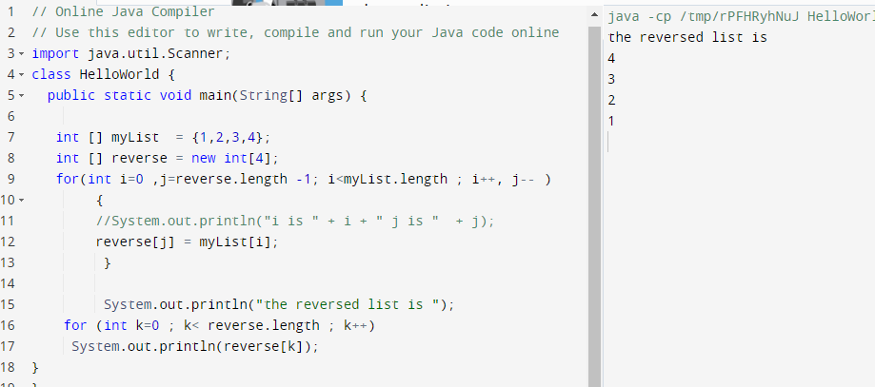
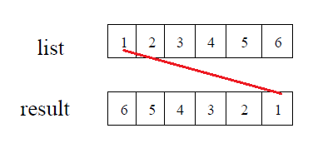
Reverse an array

Slide 2
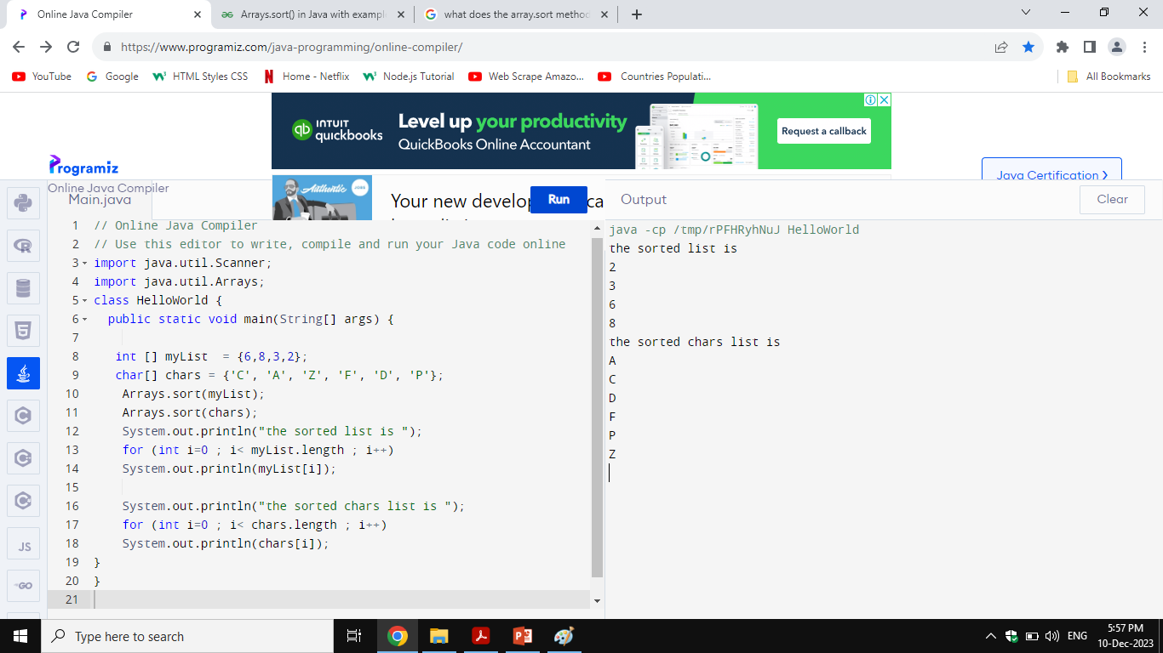
Sort an Array

Slide 3
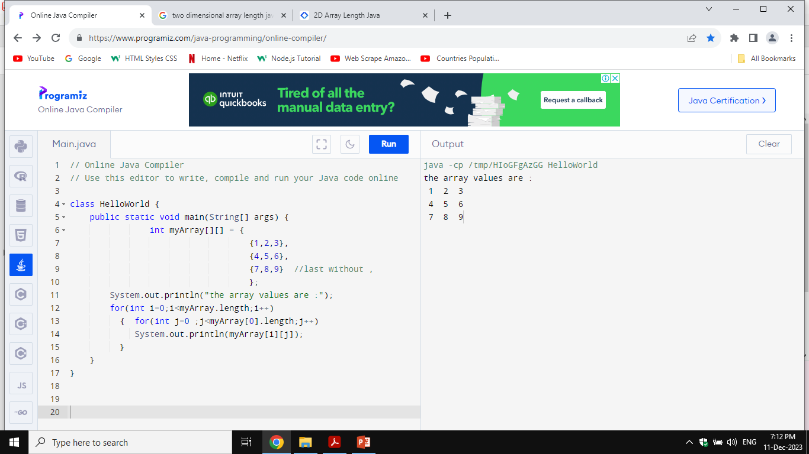
Double dimension array list[i][j]

Slide 4
Lengths of Two-dimensional Arrays
Int [][] myArray = new int[i][j];
i is the number of rows
j is the number of columns
Int [][] myArray = new int[10][5];
Row length is :int lengthRow = myArray.length;
Col length is :int lengthCol = myArray[0].length;

Slide 5
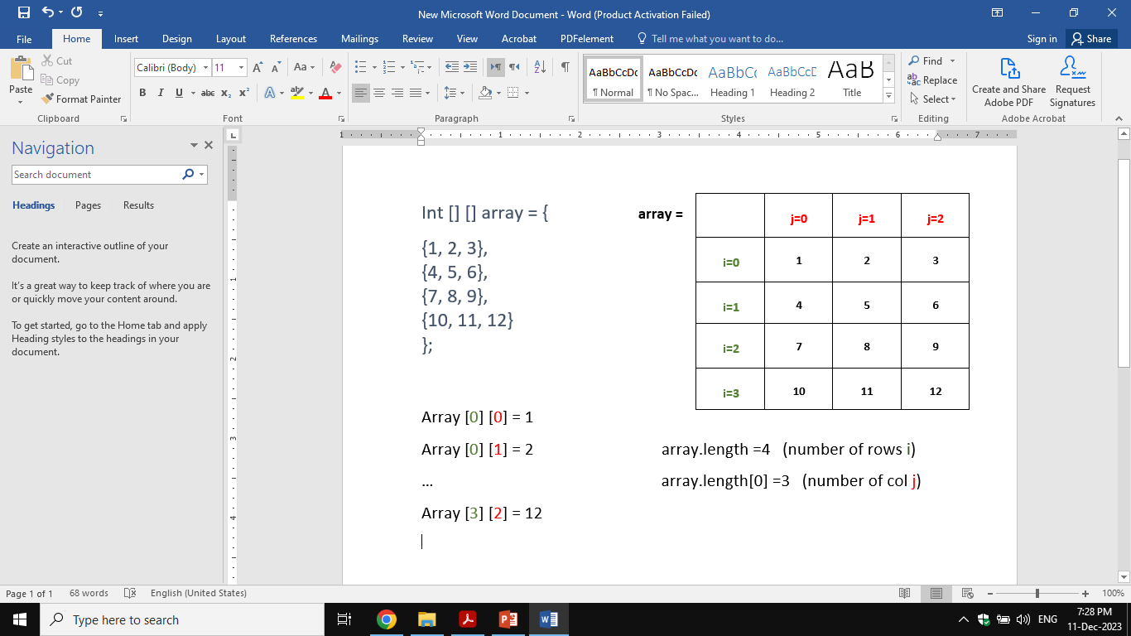
Lengths of Two-dimensional Arrays

Slide 6
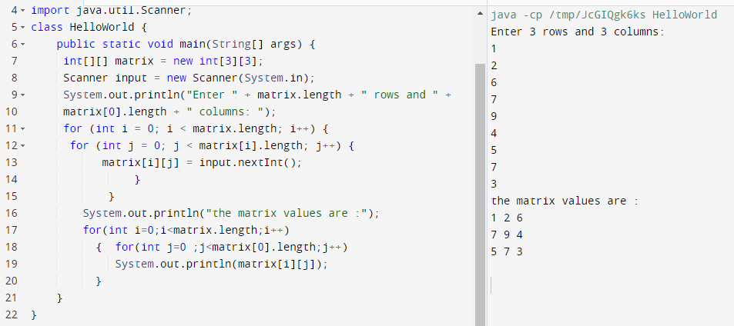
Reading Array value from console(Scanner)

Slide 7
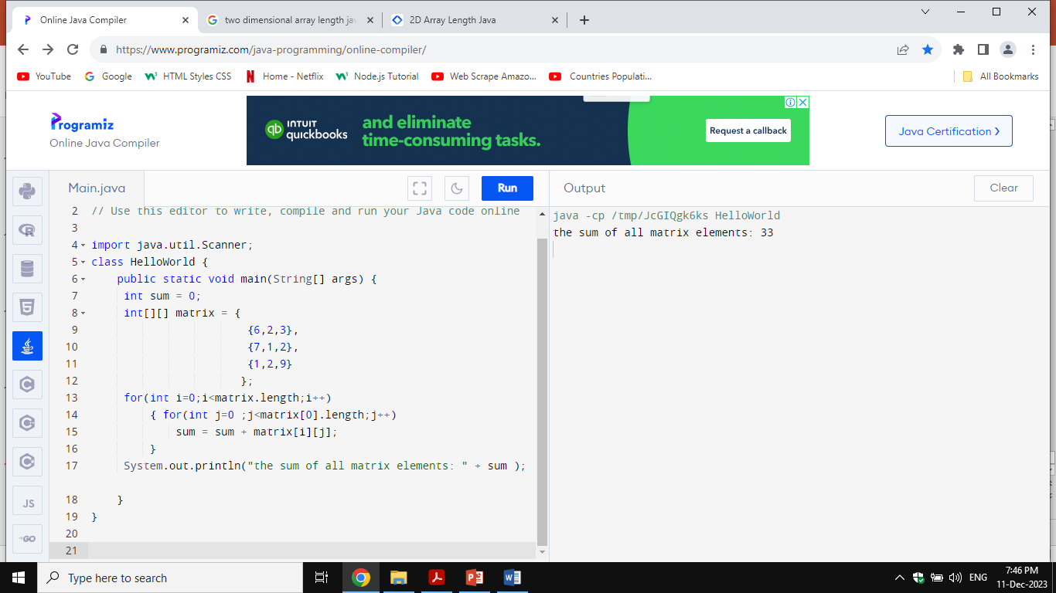
Sum of array elements

Slide 8
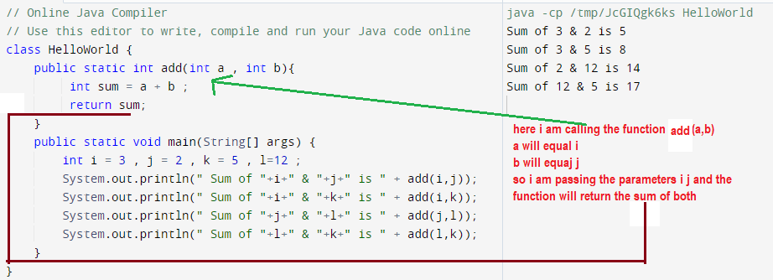
Java Functions (methods)

Slide 9
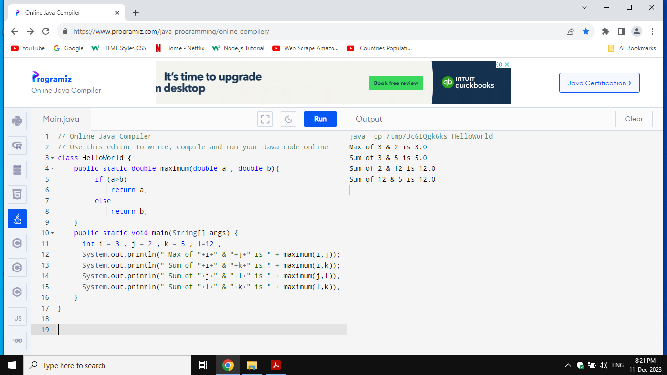
Java Functions (methods)
We use functions to reduce redundant coding . We set up the code , we give the function it’s parameters , and we call it whenever we like by passing our own parameters to replace it’s parameters.
Another example the maximum between 2 numbers

Slide 10
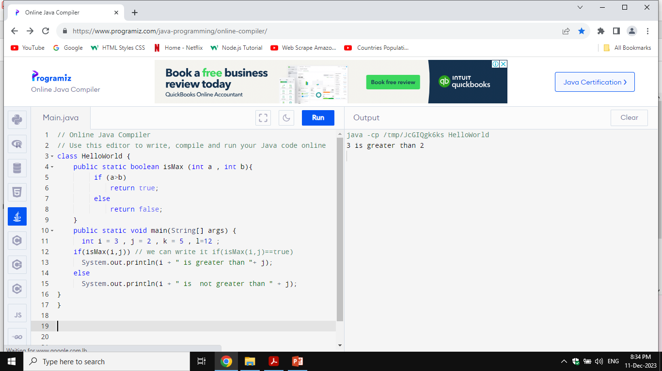
Boolean function
if(isMax(i,j)) is the same as if(isMax(i,j) ==true)
if(!isMax(i,j)) is the same as if(isMax(i,j) ==false)

Slide 11
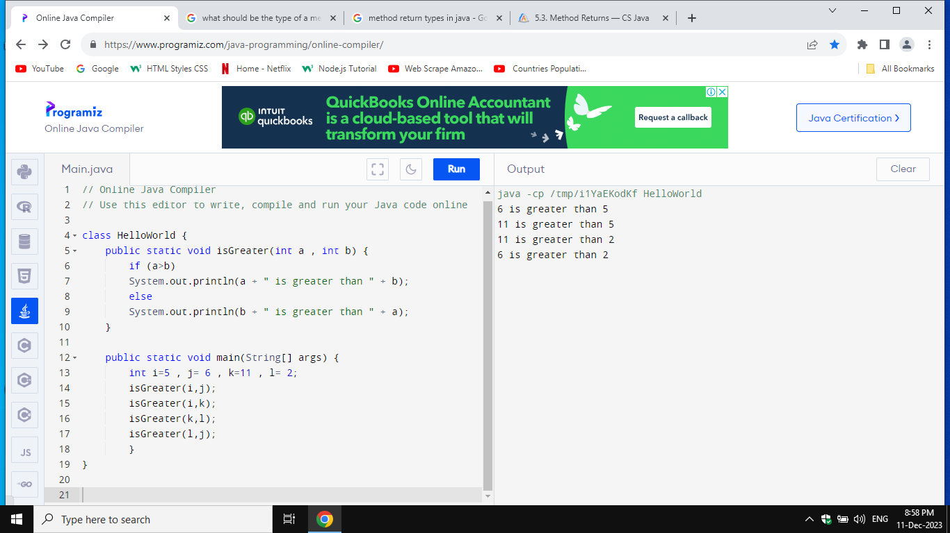
Printing inside a method
N.B a void method will not return a value
an int method will return an int
a Boolean method will return true or false

Slide 12
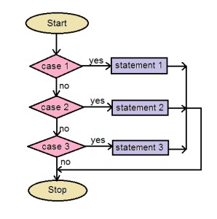
Switch case

Slide 13
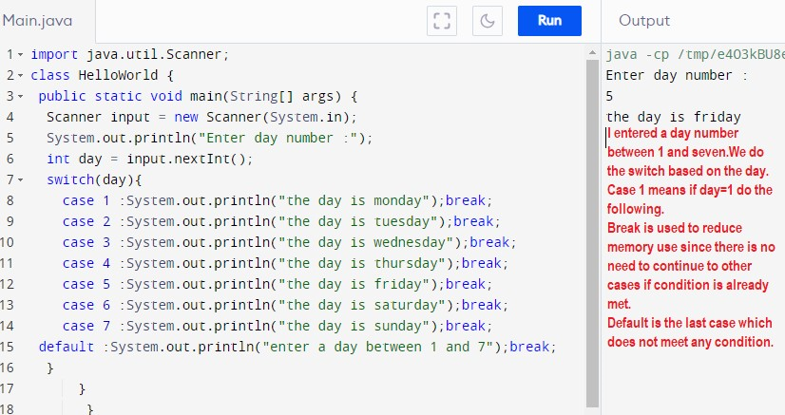
Switch case

Slide 14
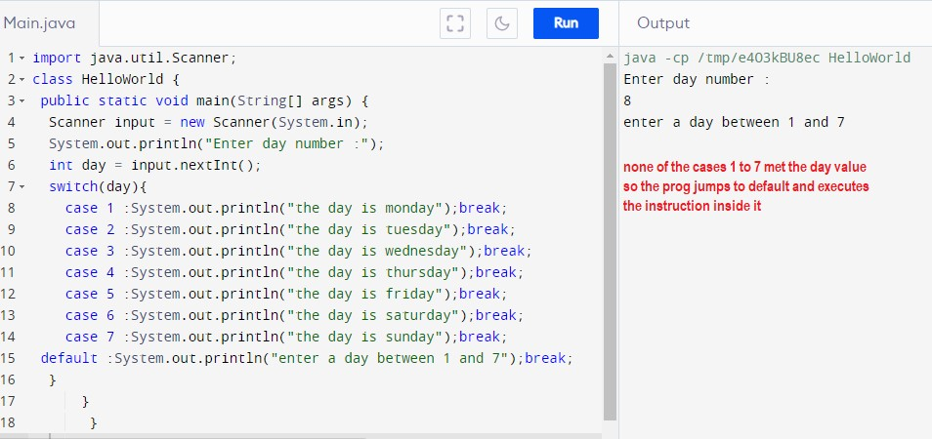
Switch case

